Slide 1
Distance Time graphs
Year 11 Mathematics

Slide 2
Distance-Time Graphs
In a distance - time graph, time always goes along the bottom axis.
Example:
This graph shows a journey taken by a cyclist one day.
Distance from home
(km)
Calculate the speed for part A.
10
9
Speed
= distance ÷ time
8
= 4
÷ 20
7
= 0.2 km per minute
6
x by 60
to convert to km per hour
5
0.2 x 60
4
3
A
2
4
1
20
12 km per hour
0
0
10
20
30
40
50
60
70
80
90
100
Time (minutes)

Slide 3
Distance-Time Graphs
In a distance - time graph, time always goes along the bottom axis.
Example:
This graph shows a journey taken by a cyclist one day.
Distance from home
(km)
C
What happened at parts B and C?
10
9
If the graph is horizontal, there is no movement.
8
7
6
So one explanation could be:
5
B
4
3
2
1
The Cyclist Rested
0
0
10
20
30
40
50
60
70
80
90
100
Time (minutes)

Slide 4
Distance-Time Graphs
In a distance - time graph, time always goes along the bottom axis.
Example:
This graph shows a journey taken by a cyclist one day.
Distance from home
(km)
Calculate the speed for part D.
10
9
Speed
= distance ÷ time
8
= 10
÷ 30
7
D
= 0.3333 km per minute
6
x by 60
to convert to km per hour
5
10
0.3333 x 60
4
3
2
1
30
20 km per hour
0
0
10
20
30
40
50
60
70
80
90
100
Time (minutes)

Slide 5
24
7
30
Date: 23/10/2018
Speed Distance Time
EQ – How do Distance Time graphs tell a story?
What do different slopes mean?
A horizontal section indicates there is no movement / stationary
A steep line indicates high speed / fast
A gently sloping line indicates a low speed / slow
A straight line indicates constant speed, a change in the slope means there is a change in the speed
Going up means going away, going down means coming back

Slide 6
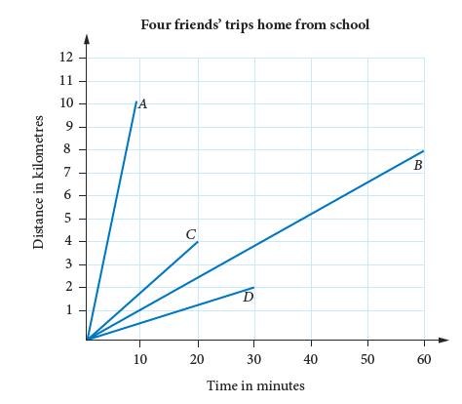
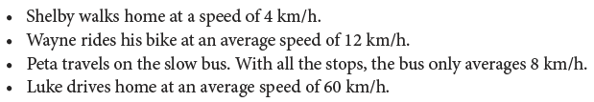
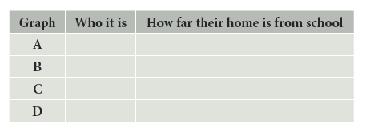
Task
Notes:
After this task set the whiteboard to graph and have each member of the class come up to the board and put their distance and time to get home
Comment on how the slopes of the walking are (should be) similar
Car slopes similar etc
Steep = fast

